Slide 1
Artificial Intelligence

Slide 2
Definition
Artificial intelligence (AI) is the ability of a computer or a robot to do tasks without human interaction, that are usually done by humans.

Slide 3
There are 2 types of AI
ALMOST NO PROGRESS
ANI
Artificial Narrow Intelligence
AGI
Artificial General Intelligence
LOTS OF PROGRESS
Notes:
There is a lot of excitement but also a lot of unnecessary hype about AI.
AI is actually two separate ideas.

Slide 4
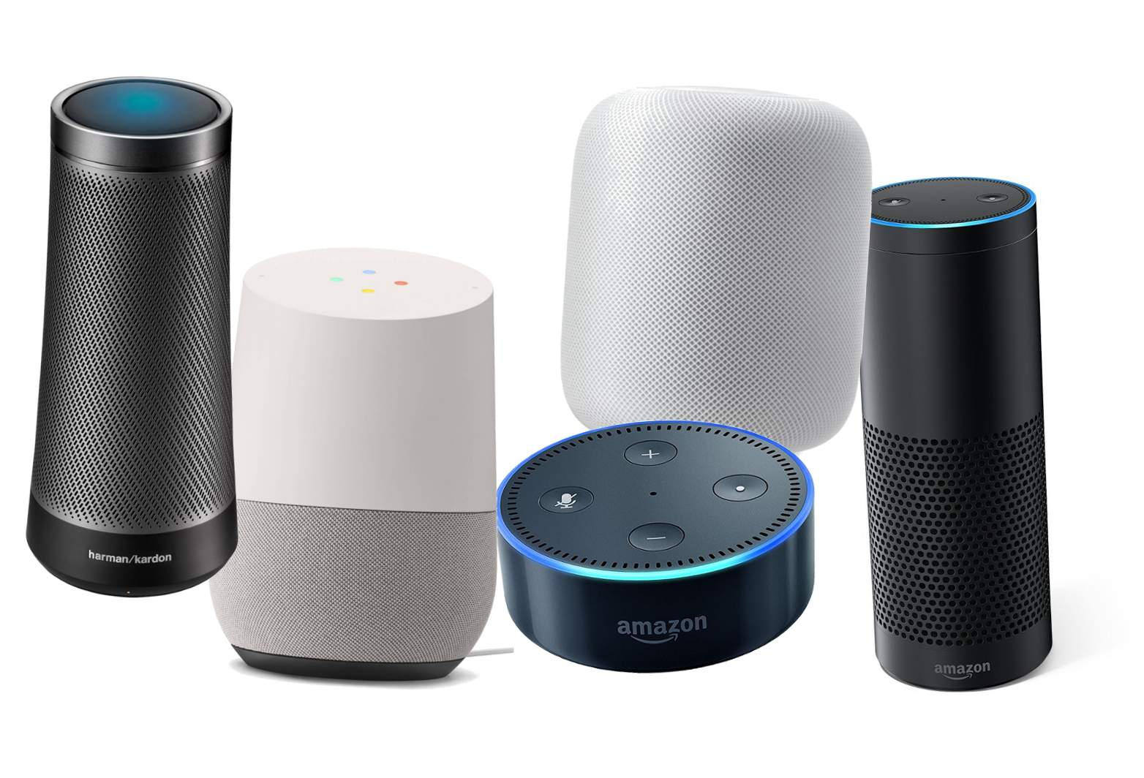
Artificial Narrow Intelligence (ANI)
These are AIs that do one thing such as:
smart speaker
self-driving car
AI to do web search
AI applications in farming or in a factory.
These types of AI are one trick ponies but when you find the appropriate trick, this can be incredibly valuable.

Slide 5

Artificial General Intelligence (AGI)
That is the goal to build AI.
They can do anything a human can do or maybe even be superintelligent and do even more things than any human can.

Slide 6

Progress in ANI vs AGI
The rapid progress in ANI has caused people to conclude that there's a lot of progress in AI, which is true. But that has caused people to falsely think that there might be a lot of progress in AGI as well which is leading to some irrational fears about evil clever robots coming over to take over humanity anytime now.

Slide 7
Achieving AGI Will Take Time
AGI is an exciting goal for researchers to work on, but it requires many technological breakthroughs before we get there and it may be decades or hundreds of years or even thousands of years away.

Slide 8
Machine Learning
Machine Learning is the field of study that gives computers the capability to learn without being explicitly programmed. ML is one of the most exciting technologies that one would have ever come across. As it is evident from the name, it gives the computer that makes it more similar to humans: The ability to learn. Machine learning is actively being used today, perhaps in many more places than one would expect.

Slide 9
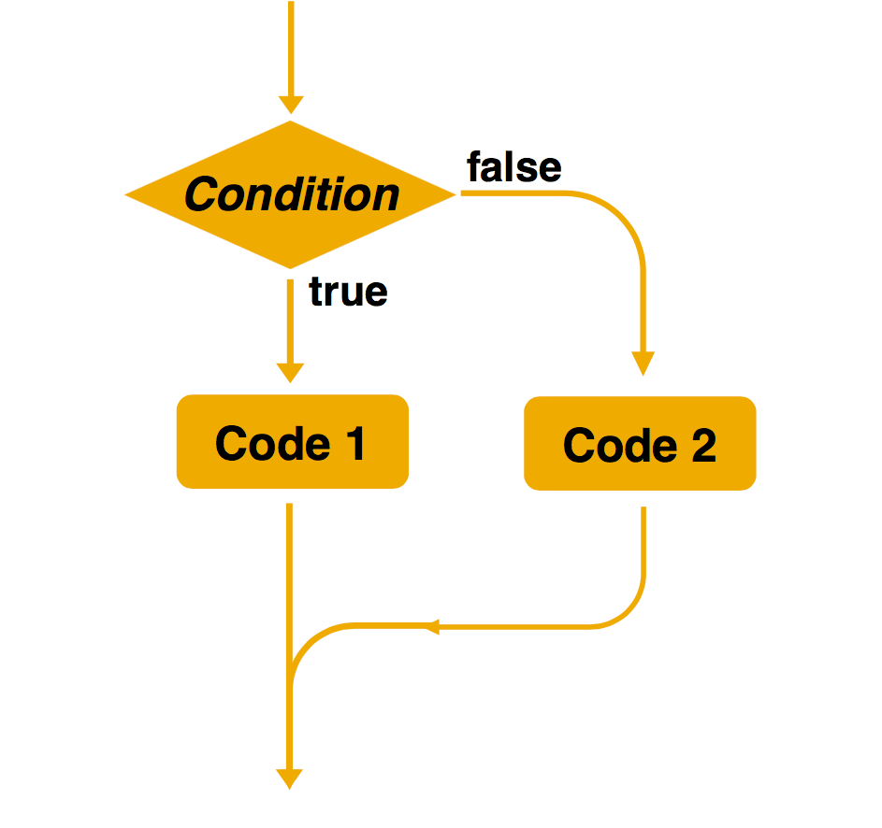
Machine Learning
Created by: Jim Liang
Rule-based algorithms
Machine learning
Training data
Machine learning
New data
Model
Prediction
Samples are used for training.
The decision-making rules are complex or difficult to describe.
Rules are automatically learned by machines.
Explicit programming is used to solve problems.
Rules can be manually specified.

Slide 10
Types of Machine Learning
Supervised Learning
Unsupervised Learning
Reinforcement Learning

Slide 11
Supervised Machine Learning
In Supervised learning technique, we train the machines using the "labelled" dataset, and based on the training, the machine predicts the output. Here, the labelled data specifies that some of the inputs are already mapped to the output. More preciously, we can say; first, we train the machine with the input and corresponding output, and then we ask the machine to predict the output using the test dataset.

Slide 12
Unsupervised Machine Learning
Unsupervised Machine Learning is one of the three main techniques of machine learning. It’s a self-organized learning algorithm in which we don’t need to supervise the data by providing a labelled dataset as it can find a previously unknown pattern in the unlabelled dataset on its own to discover useful information by performing complex tasks (such as principal component analysis and cluster analysis) as compared to the other machine learning techniques like supervised learning. So let’s see how we can do that! In this topic, we are going to learn about Unsupervised Machine Learning.

Slide 13
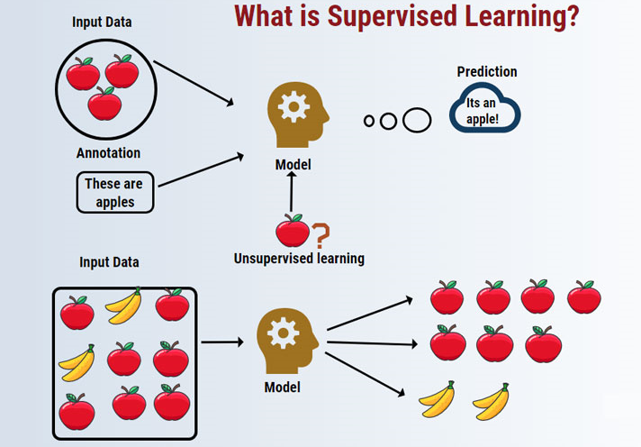

Slide 14
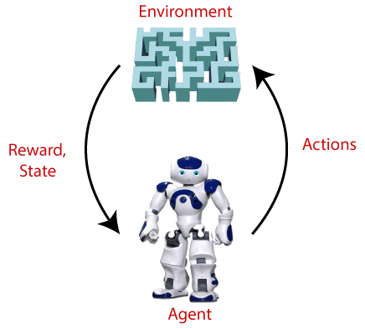
Reinforcement Learning
Reinforcement is the field of machine learning that involves learning without the involvement of any human interaction as it has an agent that learns how to behave in an environment by performing actions and then learn based upon the outcome of these actions to obtain the required goal that is set by the system two accomplish. Based upon the type of goals, it is classified as Positive and Negative learning methods with their application in the field of Healthcare, Education, Computer Vision, Games, NLP, Transportation, etc.

Slide 15
What is Data
Data is the most important part of all Data Analytics, Machine Learning, Artificial Intelligence. Without data, we can't train any model and all modern research and automation will go in vain. Big Enterprises are spending lots of money just to gather as much certain data as possible.

Slide 16
A Table of Data (Dataset)
Size of House (Square Feet) | Price ($1000)
523 | 115
645 | 150
708 | 210
1034 | 280
2290 | 355
2545 | 440
A | B

Slide 17
A Table of Data (Dataset)
Size of House (Square Feet) | # of Bedrooms | Price ($1000)
523 | 1 | 115
645 | 1 | 150
708 | 2 | 210
1034 | 3 | 280
2290 | 4 | 355
2545 | 4 | 440
A |  | B

Slide 18
Another example
If you have a certain budget and you want to decide what is the size of house you can afford, then you might decide that the input A is how much does someone spend and B is just the size of the house in square feet, and that would be a totally different choice of A and B that tells you, given a certain budget, what's the size of the house you should be maybe looking at.

Slide 19
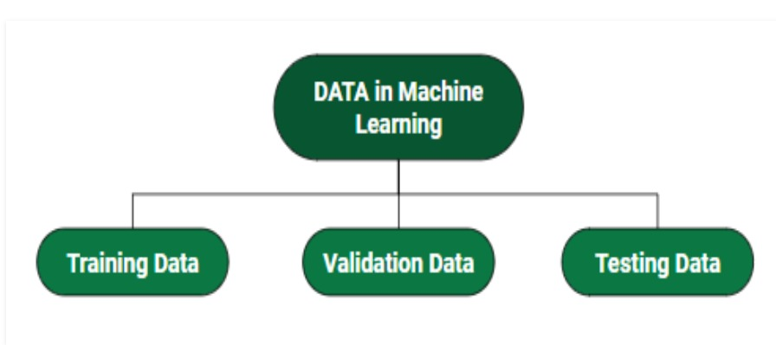
Dataset Splitting

Slide 20

Acquiring data
Manual labeling

Slide 21
Data is Messy
Not a cat
Not a cat
Cat
Cat

Slide 22

Data is Messy
If you have bad data, then the AI will learn inaccurate things.
Data problems:
Incorrect labels
Missing values
Multiple types of data
Unstructured Data: Images, audio, text

Slide 23
Data Science
If you want to have a team analyze your dataset in order to gain insights. The output of a data science project is a set of insights that can help you make business decisions
So, a team might come up with conclusions like:
"Hey, did you know if you have two houses of a similar size, they've a similar square footage, if the house has three bedrooms, then they cost a lot more than the house of two bedrooms, even if the square for this is the same."

Slide 24
Data Science
"Did you know that newly renovated homes have a 15% premium, and this can help you make decisions such as, given a similar square footage, do you want to build a two bedroom or three bedroom size in order to maximize value? "
"Is it worth an investment to renovate a home in the hope that the renovation increases the price you can sell a house for?"
The output of a data science project is a set of insights that can help you make business decisions, such as what type of house to build or whether to invest in renovation.

Slide 25
Formal Definition of Data Science
Data science is the science of extracting knowledge and insights from data.
So, the output of a data science project is often a slide deck, the presentation summarizes conclusions for executives to take business actions or summarizes conclusions for a product team to decide how to improve a website.

Slide 26
Examples of what ML can and can’t do?
Identifying the intent of the customer - Possible
Writing an emphatic response to customer’s email – Not possible or difficult

Slide 27
Deep Learning
Deep learning is a subset of machine learning in artificial intelligence, i.e., based upon artificial neural network and representation learning, as it is capable of implementing a function that is used to mimic the functionality of the brain by creating patterns and processing data. Deep Learning is also used for decision-making in fields like driverless cars ( to detect pedestrians, street lights, other cars, etc.), speech recognition, image analysis( e.g., Identifying cancer in blood and tumors), smart TV, etc.

Slide 28
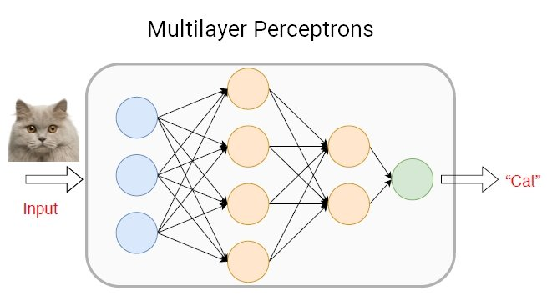

Slide 29
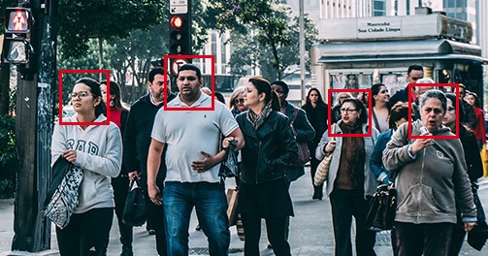
Applications of Deep Learning
Face Detection

Slide 30
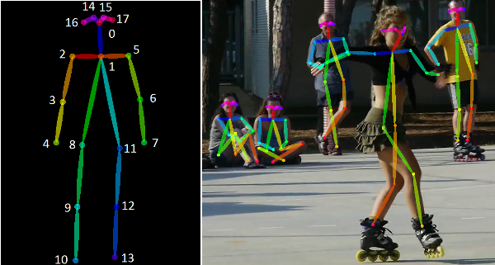
Pose Estimation

Slide 31

X-Ray Diagnosis

Slide 32
And many more…

Slide 33
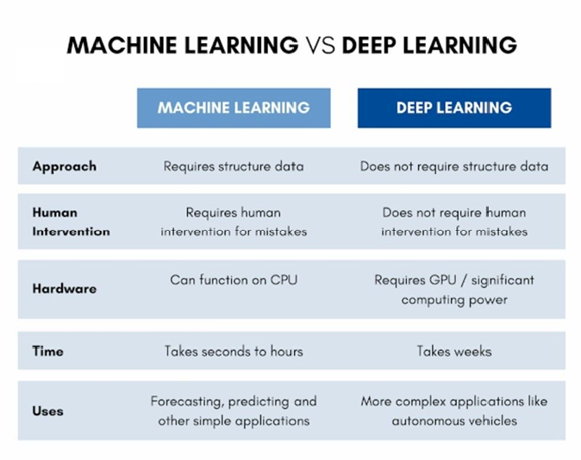

Slide 34


Slide 35
adil_2engr@hotmail.com
Write 5/10 lines of explanation in your own words:
1. Supervised learning (algorithms used in Sup Learning)
2. Unsupervised learning (algorithms used in UnSup Learning)
3. reinforcement learning (algorithms used in RI Learning)

